Slide 1
Heart health Classification
By Nishan Prajapati

Slide 2
Introduction
This project focuses on predicting the 10-year risk of coronary heart disease (CHD) using a logistic regression model trained on clinical and demographic features.
The dataset, comprising various health indicators such as gender, age, blood pressure, cholesterol levels, and smoking status, was preprocessed by handling missing values through removal and selecting.

Slide 3
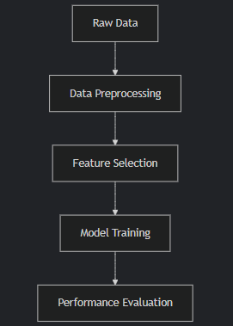
Objective
The primary objective of this project is to train and test the project on the basis of provided 4240 data training on 80% of the data and testing on the remaining 20% of the data.

Slide 4
Problem statement
This project addresses the critical healthcare challenge of early prediction of heart disease risk, specifically targeting the 10-year probability of developing Coronary Heart Disease (CHD). By analyzing patient health data through machine learning, it solves several key problems:
Data-Driven Diagnosis -
Resource Optimization -
Public Health Insight -
Accessible Screening -

Slide 5
Conclusion
This heart disease prediction project successfully implemented a machine learning workflow using logistic regression to assess the 10-year risk of coronary heart disease.
The process involved data cleaning, feature selection using training with scikit-learn's LogisticRegression, and comprehensive
This implementation serves as a foundation for developing more advanced medical diagnostic tools

